Slide 1
Breaking Down ISP Routers: Security & Privacy Insights
By: Corey Mekelburg, Ryan King, Sreean Reddy Rikkala, Alexandria Simonson

Slide 2
Project Overview
This project aims to evaluate and compare routers from the top ISPs based on their security, usability, price, and privacy. The review will be done through a grid that weighs the scores based on the category such as vulnerability management, ease of setup, affordability, and functionality. The findings will be put into a webpage that will help the consumers make informed decisions about their router choices providing information into vulnerabilities, security hardening tips, etc.

Slide 3
Objectives
Research Consumer Router Usage Trends
Identify strengths and weaknesses in the top ISP provided routers and supported routers
Create a Comparison Grid
Evaluate Reliability of Manufacturer
Analyze Router Usability
Compare Pricing Tiers
Assess Router Security
Provide security insights and hardening tips
Develop Website Presenting Results

Slide 4
Methodology
Selecting ISPs & Routers
Defining Evaluation Criteria (expanded on right)
Security
Usability
Price
Performance
Privacy
Creating the Comparison Grid
Data Collection & Testing
Security Hardening Tips:
Website Development
Report Creating

Slide 5
Comparison Grid
Sample Grid:
Category | Criteria | Weight | Rating (1-5)
Security | Default security settings, firmware updates, known vulnerabilities, admin controls | 25% | 4
Usability | Setup process, interface, customization, ISP restrictions | 20% | 3
Price | Rental fee, hidden costs | 15% | 2
Performance | Speed, Wi-Fi standard, range | 20% | 4
Privacy | ISP control, DNS settings, ad-blocking | 15% | 3
Final Weighted Score | Overall score | 100 | 3.2/5

Slide 6
Expected Benefits
The results of this project are expected to benefit not only consumers, but also ISPs and manufacturers
For consumers it will help make decisions about choosing a router easier and assist by showing the strengths and the weaknesses of the routers.
Consumers will also receive helpful information regarding device configuration.
For the ISPs and manufacturers, it will help to show areas of improvement of their devices.

Slide 7
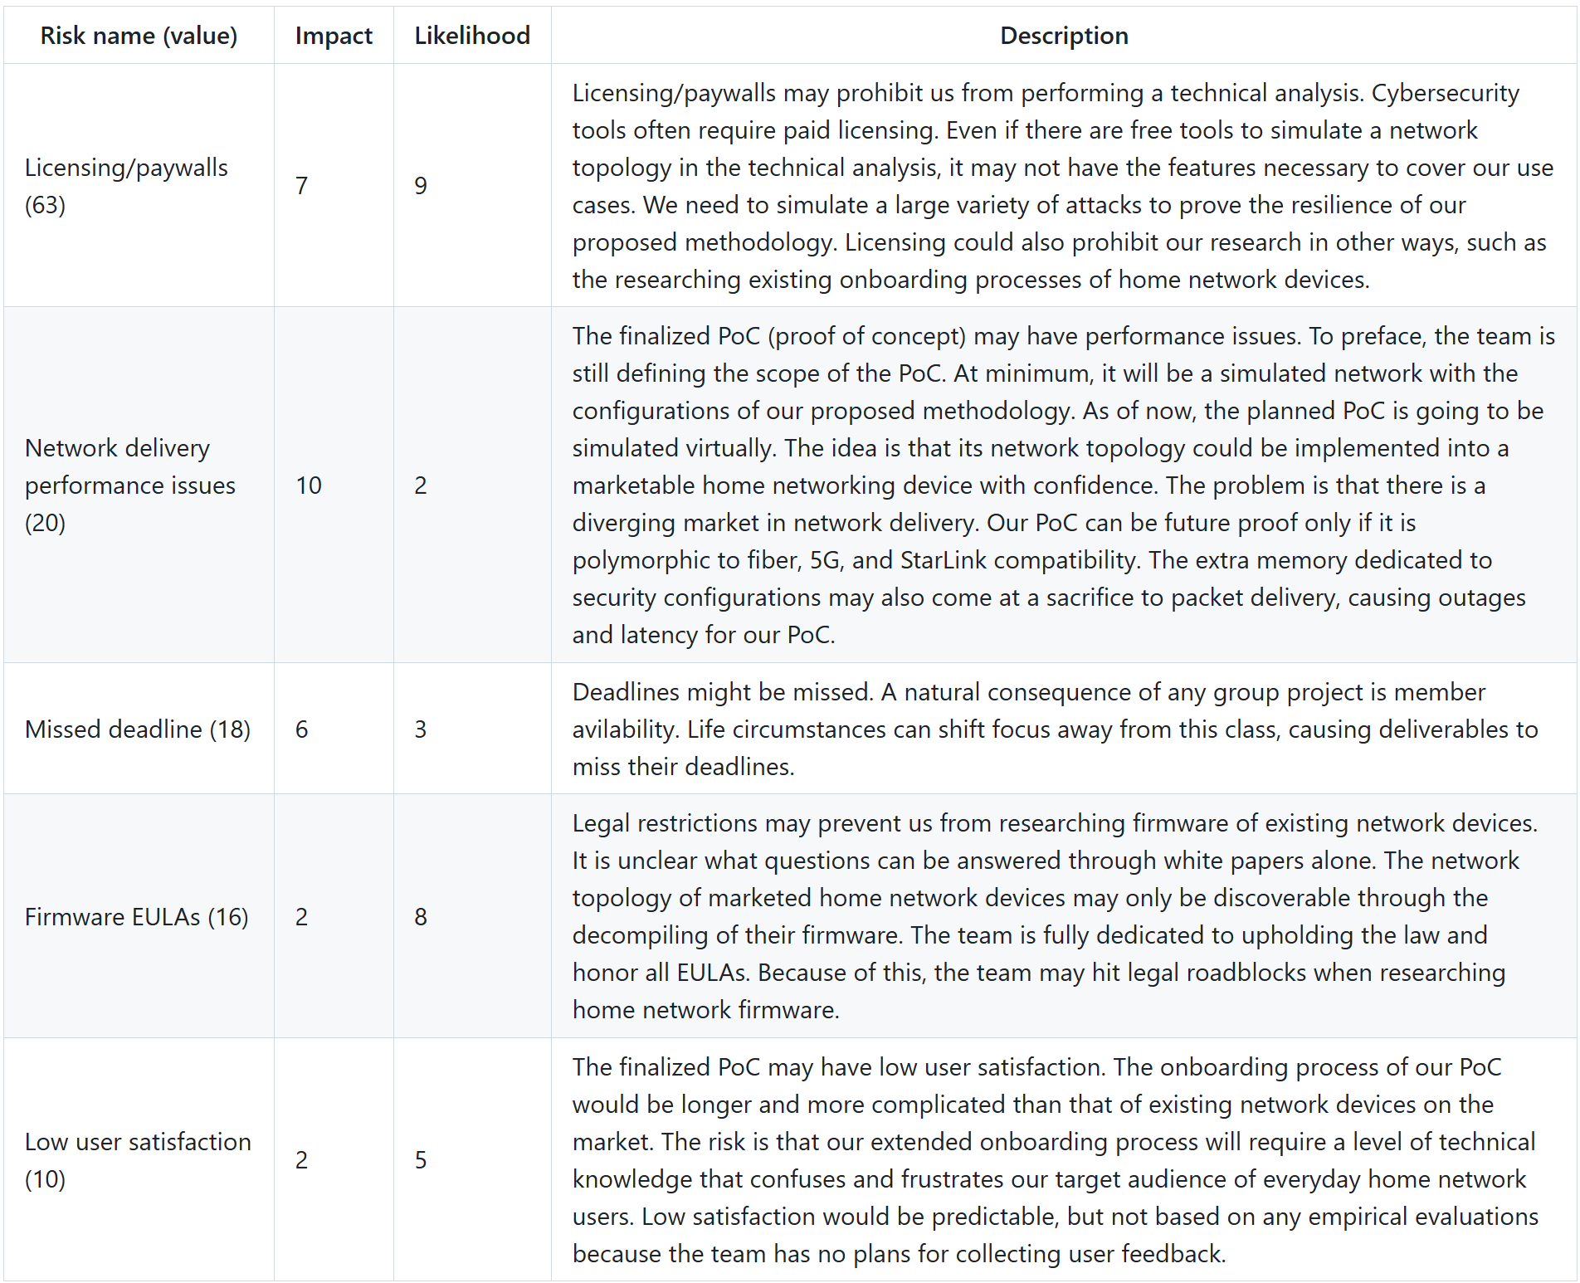
Challenges & Considerations

Slide 8
Conclusion
Research common vulnerabilities affecting consumer routers
Evaluate ISP routers
Identify security gaps
Develop security hardening recommendations
Provide recommendations for consumers
Provide feedback to ISP based on findings
Summary: Choosing the correct router and configuring its security settings based on user needs can improve home network security, provide better user experience, and ensure the privacy of the user’s data.

